Slide 1
Project Plan

Slide 2
Understanding Requirements and Database Design.
Creating Solution and Adding projects to It.
Creating The business Objects.
Creating Data Access Layer in EF.
Creating Business Logic Layer in C#.Net.
Creating Presentation Logic Layer in MVC5.
Designing Models, Controllers and Views.
Business Rules Validations.
Securing Your App.
Implementing Transactions.
Ajaxifying Your App.
Conclusion And Feedback

Slide 3
Finalized Requirements
Link hub is a web portal where a user can submit their portal URL under a specific category to be shared on link hub. Admin can approve or reject the URL submitted by the user and in each case an email is sent out to the user. Once the link is approve it will be available on the link hub portal under a specific category.

Slide 4
Defining the Roles & Responsibilities
Roles:
User
Can Browse URLs
Can Submit A URL
Can CRUD Category

Slide 5
Identifying the Objects
User
Category
Url

Slide 6
Creating The Relationships
Category : Url
1--------------------> n
n--------------------> 1 (X)
n--------------------> n (X)
(1:M)

Slide 7
Creating The Relationships
User : Url
1--------------------> n
n--------------------> 1 (X)
n--------------------> n (X)
(1:M)

Slide 8
Creating The Relationships
Objects
User
Category
Url
Relationships
Category : Url
(1:M)
User : Url
(1:M)

Slide 9
Designing Database
tbl_User
UId
Role
tbl_Category
CategoryId
tbl_Url
UrlId
UId
CategoryId

Slide 10
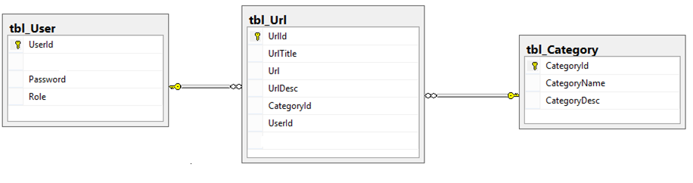
Implementing Database
Lets go and Implement

Slide 11
Design Project Arch.
Business Objects (BO)
UI
Asp.Net MVC
a=10;
b=20;
show c
BLL
C#.Net
c=a+b
DAL
Ado.Net
EF
Result c
Database
MS SQL

Slide 12
Design Project Arch.
UI
BLL
DAL
BOL

Slide 13
Creating Solution and Adding projects to It
Lets go and implement it

Slide 14
Creating Of UI/PL
Business Objects (BO)
Business Objects (BO)
UI
Asp.Net
MVC
a=10;
b=20;
show c
UI
Asp.Net
a=10;
b=20;
show c
BLL
C#.Net
c=a+b
DAL
Ado.Net
EF
Result c
Database
MS SQL
Database
MS SQL

Slide 15
Roles & Responsibilities
Roles:
User
Can Browse URLs
Can Register
Can Submit A URL

Slide 16
Home

Slide 17
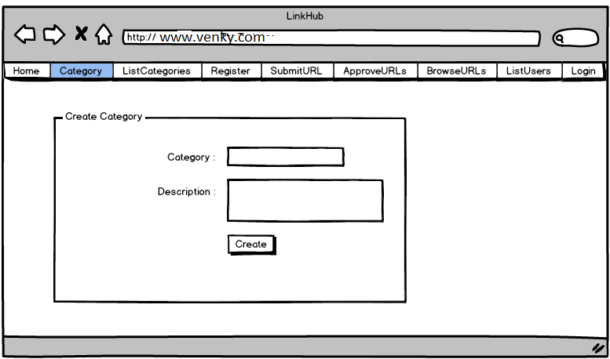
Category

Slide 18
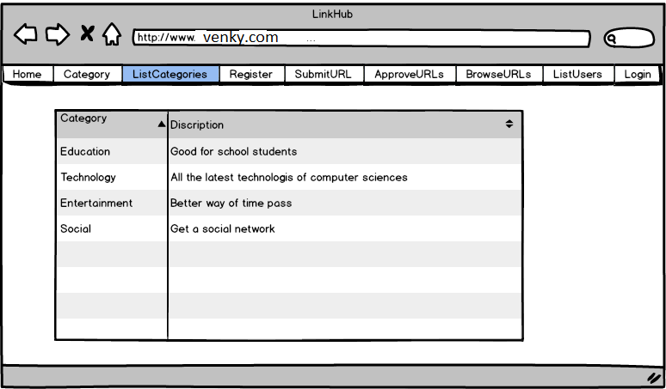
ListCategories

Slide 19
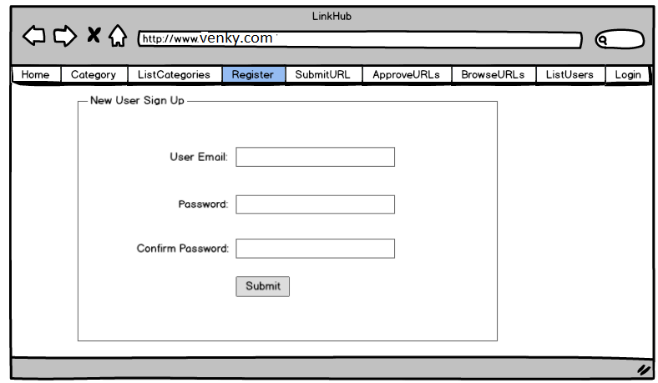
Register

Slide 20
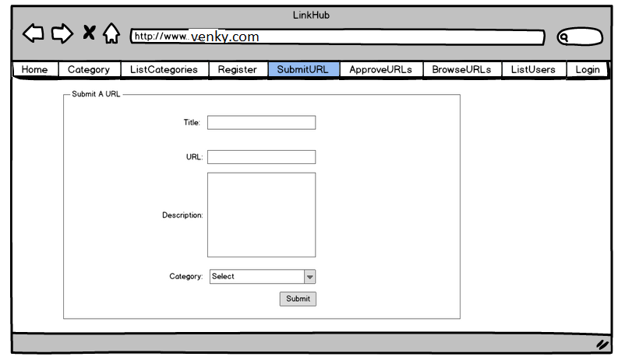
SubmitURL

Slide 21
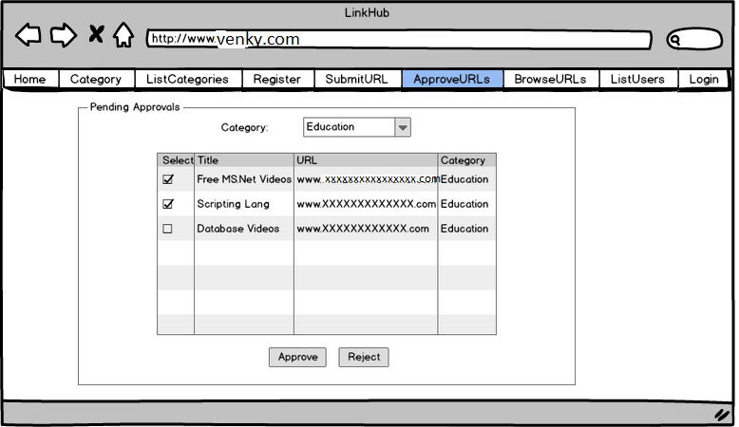
ApproveURLs

Slide 22
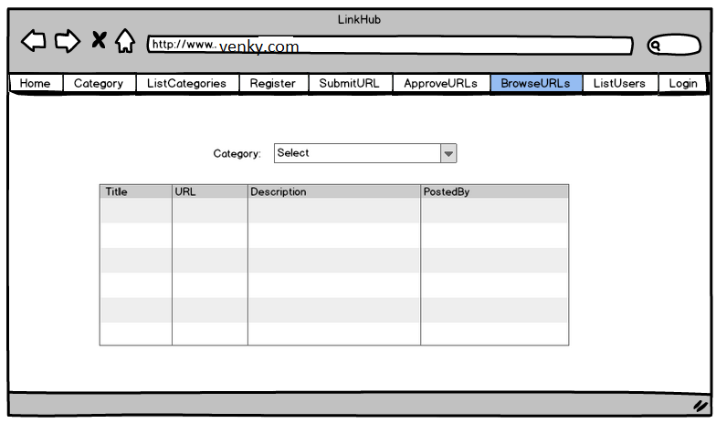
BrowseURLs

Slide 23
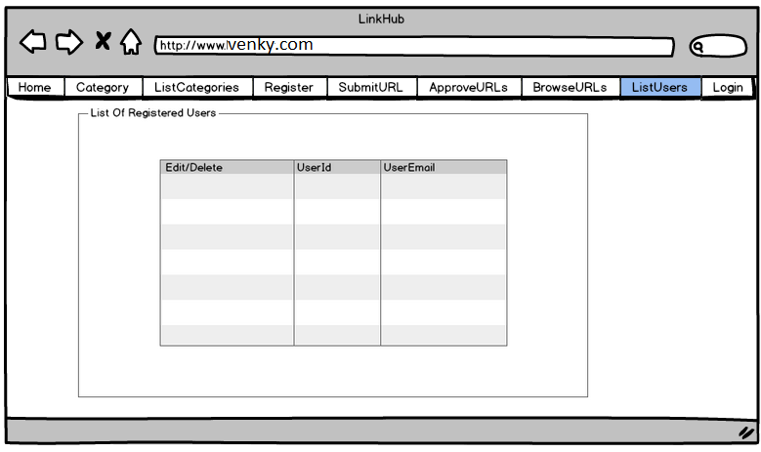
ListUsers

Slide 24
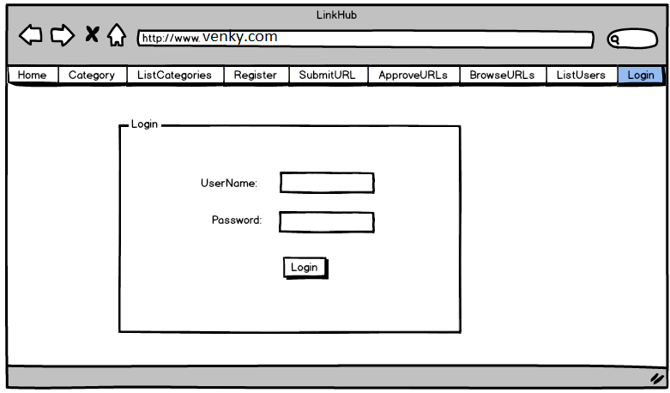
Login

Slide 25
UI - Modules
User
SubmitURL
Admin
Category
ListCatergories
ListUsers
ApproveURLs
Common
Home
BrowseURLs
Security
Login
Register

Slide 26
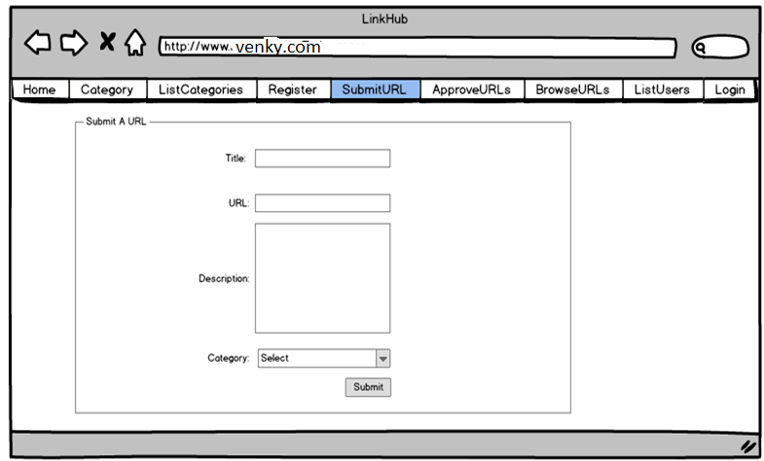
SubmitURL

Slide 27
User Controllers Design
Controller | Action
URL | Index [Display Form - HttpGet]
 | Create [Submit Form - HttpPost]

Slide 28
Admin Controllers Design
Controller | Action
Category | Index[Display Form - HttpGet]
 | Create [Submit Form - HttpPost]
ListCategory | Index [Display List - HttpGet]
ListUser | Index [Display List - HttpGet]
ApproveURLs | Index [Display List - HttpGet]
 | Approve [Submit Form- HttpPost]

Slide 29
Common Controllers Design
Controller | Action
Home | Index [Display Calender - HttpGet]
BrowseURLs | Index [Display List Form - HttpGet]

Slide 30
Security Controllers Design
Controller | Action
Login | Index[Display Form- HttpGet]
 | SignIn[Submit Form - HttpPost]
Register | Index[Display Form - HttpGet]
 | Create[Submit Form- HttpPost]

Slide 31
Creating Data Access Layer
Lets go and implement it

Slide 32
Creating Business Logic Layer
Lets go and implement it

Slide 33
Creating Of UI/PL
Business Objects (BO)
Business Objects (BO)
UI
Asp.Net
a=10;
b=20;
show c
UI
Asp.Net
a=10;
b=20;
show c
BLL
C#.Net
c=a+b
BLL
C#.Net
c=a+b
DAL
Ado.Net
Result c
DAL
Ado.Net
Result c
Database
MS SQL
Database
MS SQL

Slide 34
Form Validations
Lets go and implement it

Slide 35
Business Rule Validations
Lets go and implement it

Slide 36
Authorization
Lets go and implement it

Slide 37
Applying Bootstrap Theme
Lets go and implement it

Slide 38
Advanced Operations
Binding multiple models to a single View
Implementing transactions
Ajaxifying MVC App
External Logins [Like Facebook Login]

Slide 39
Thanks
☺

